Slide 1
Operational Cyber Security Management Cyber Breach Cases Research and Control Recommendations
Bryan Goodwin & Natnael Kebede
University of Dallas
August 5, 2019

Slide 2

The National Bank of Blacksburg Data Breach [Hacking or malware (HACK)]
Breach occurred twice in eight months due to sophisticated phishing techniques (eye pyramid attack vector) deployed by hackers.
The Email allowed them to install malware on an employee’s computer and compromise another computer that has access to the STAR network (May 28, 2016)
May 31, 2016, they utilized ATM to withdraw $569,000
2nd phishing email (Jan 7, 2017) regained access to the STAR
- Total of $1,833,894 dispensed this time
Hackers stole a total of $2.4 M stole in both incidents
Vulnerability:
Lack of effective employee training
Failure in controls:
Network compromise
By passing PINS
By passing daily withdrawal limits

Slide 3
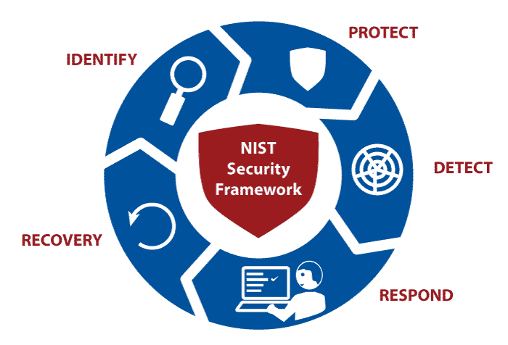
The National Bank of Blacksburg [Control Recommendations]
Before applying any controls, the Banks should start with:
Information Security Workforce & Training
Asset Vulnerabilities and Pen Testing
Once this is done, protection mechanisms should include
Adaptive Identification and Authentication
Network Integrity through segmentation
Security Awareness Training
Continuous Monitoring for threats & appropriate authorization of controls in a highly dynamic environment.
Malicious code protection
While trying to recover from the incident and restore normal business operations, don’t forget lessons learned too
Notes:
Network segmentation can protect against this attack by allowing the organization to physically separate the corporate network into multiple subnetworks with managed interfaces. This can be accomplished with firewalls, gateways, or routers and controlling the flow of connections to the systems (“NIST Special Publication 800-53 Revision 5, Security and Privacy Controls…”, 2017).
Detection mechanisms such as antivirus or other software products at information system entry and exit points (e.g. electronic mail servers, web servers, remote-access servers) and workstations to detect malicious code and prevent its execution (“NIST Special Publication 800-53 Revision 5, Security and Privacy Controls…”, 2017).

Slide 4

Boeing Data Breach [Unintended Disclosure (DISC)]
Breach occurred on Nov 21, 2016 when an employee emailed a spreadsheet to his spouse (who doesn’t work for Boeing) to get help with data formatting.
Employee wasn’t aware of sensitive employees’ data in hidden columns
DOB, SSN
Other data included
Employee ID, Full Name, Place of Birth, Accounting Department Codes
PII of 36,000 workers exposed
- 7,288 Washington Residents
Cost of breach might be as high as $5.7 M
Vulnerabilities:
Lack of DLP software
Lack of adequate employee training
Notes:
Data loss prevention software (DLP) refers to the technologies that provide remediation for data loss based on content inspection and contextual analysis of data that is at rest, in motion, and in use.

Slide 5
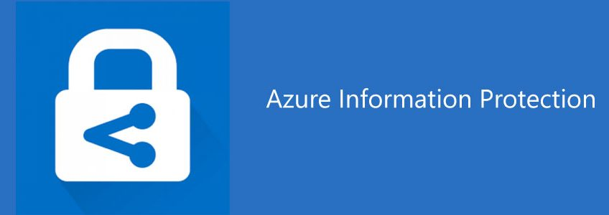
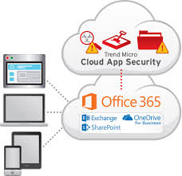
Boeing [Control Recommendations]
Cloud Based Security Controls
Applying labels to classify various types of data
By creating labels, restricting access to contents is possible.
Only authorized employees can open the document or email it.
Only authorized employees in a certain department can edit or print the document
Employees cannot copy sensitive corporate information or forward it an email
Data Transmission Protection Mechanism
Effective Employee and Security Awareness Training
DLP tools and policies
Information Security Monitoring
Real time anomaly detection and behavioral analysis
Incident Analysis
Understanding the scope and impact of the breach
Lessons Learned
Notes:
Azure information protection also knows as AIP provides an effective and efficient cloud-based solution to help organizations classify and protect their documents. According to Microsoft’s Azure specifications, labels can be applied manually by employees, automatically by administrators who define rules and conditions, or a combination of both. In the same manner, emails can be configured to prevent employees from attaching such documents or forwarding emails that contain the sensitive attachments.
Microsoft Cloud App Security allows organizations to create anomality detection policies and utilize behavioral analysis to obtain real time detections targeted at prohibited employee activities. Based on the policy results, security alerts are triggered when some action occurs that is different from the set employee privileges by the organization (“Create anomaly detection policies in Cloud App Security | Microsoft ...”, 2019).

Slide 6

Tesla Data Breach [Insider Attack (INSD)]
Breach occurred beginning of May 17, 2018 due to a disgruntled employee using his trusted access to the company’s network to expose data.
Employee was able to alter Tesla’s manufacturing OS by making direct code changes
Source code was designed to periodically send data to 3rd parties even after he leaves Tesla
Also downloaded sensitive large company data and exported it to third parties
This included trade secrets, financial information, confidential photos, video of Tesla’s manufacturing systems
Tesla filed a lawsuit against the employee for $167 M in damages.
Vulnerabilities:
Lack of Effective Insider Monitoring

Slide 7
Tesla [Control Recommendations]
The process for asset monitoring and tracking is a primary key to identify an inside attack.
Deterrence controls and protective technologies
Separation of duties
Insider Monitoring and enforcing policies
Fostering a culture of open discussion
DLP, IAM, and encryption technologies
Detection Controls
Some of these tools include intrusion detection and prevention systems (IDS/IPS), log management, and security Information and event Management (SIEM)
Incident Analysis
Understanding the scope of the breach
strategies to resume business and stay in the market.
Lessons Learned
Notes:
Specific deterrence controls should be designed to avert insider attacks. These controls include Data Loss Prevention (DLP), Identity and Access management (IAM), and encryption of data whether it is at rest, in motion or in use (“Insider Threat Report: 2018”, n.d.).
Whether an inside threat occurs for malicious purposes, through an honest mistake or carless employee behavior, monitoring limits the risk exposure by allowing the security team to quickly detect the unusual employee activity on systems (“Insider Threat Report: 2018”, n.d.). Some indicators of such employee behaviors to watch out for include below average work, hostility towards other employees, coming in late and leaving early, working outside normal business hours, declining performance, and passive-aggressive behavior (Ballad, Banks, Chapple & Ballad, 2017).
Encouraging a periodic discussion between employees and their managers can diffuse insider threats (Ballad, Banks, Chapple & Ballad, 2017).
We suggest using more than one security tool for any organization including Tesla. Some of these tools that we recommend include Intrusion Detection and Prevention Systems (IDS/IPS), Log Management, and Security Information and Event Management (SIEM) (“Insider Threat Report: 2018”, n.d.).

Slide 8

Michigan Medicine, University of Michigan Data Breach [Portable Device (PORT)]
Breach occurred on June 3rd, 2018 when an employee’s personal laptop was stolen from employee’s car.
Laptop hard drive was not encrypted.
Contained health and medical research records for approximately 870 patients.
Employee violated policies by downloading research data onto personal devices also storing research data on unencrypted media.
Data included patient names, birthdates, gender, race, diagnosis, and treatment-related information.

Slide 9
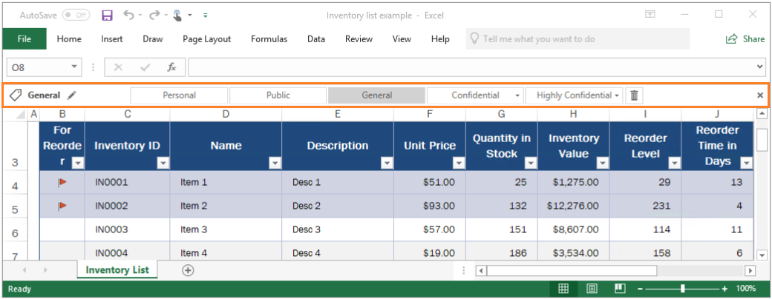
Michigan Medicine, University of Michigan [Control Recommendations]
Data Identification, Classification, Labeling
Restrict sensitive data
Enterprise Mobility Management
Force full disk encryption
Remote wipe
Rogue Device Identification
One of the primary risks for companies? - End users
Establishing policy is not enough
- Training and consequences
Logging
SIEM system
Audit, Audit, Audit

Slide 10

Jason’s Deli Data Breach [Payment Card Fraud (CARD)]
On December 12, 2017, Del Management Inc., was alerted that credit card information linked to 164 of its 264 locations were for sale on the dark web.
RAM-scraping malware running on point-of-sale (POS) terminals captured and transmitted card information to an external server.
Breach began on June 8th, 2017 and ran until detected in December.
Approximately 2 million payment cards impacted across 164 of 264 stores.

Slide 11
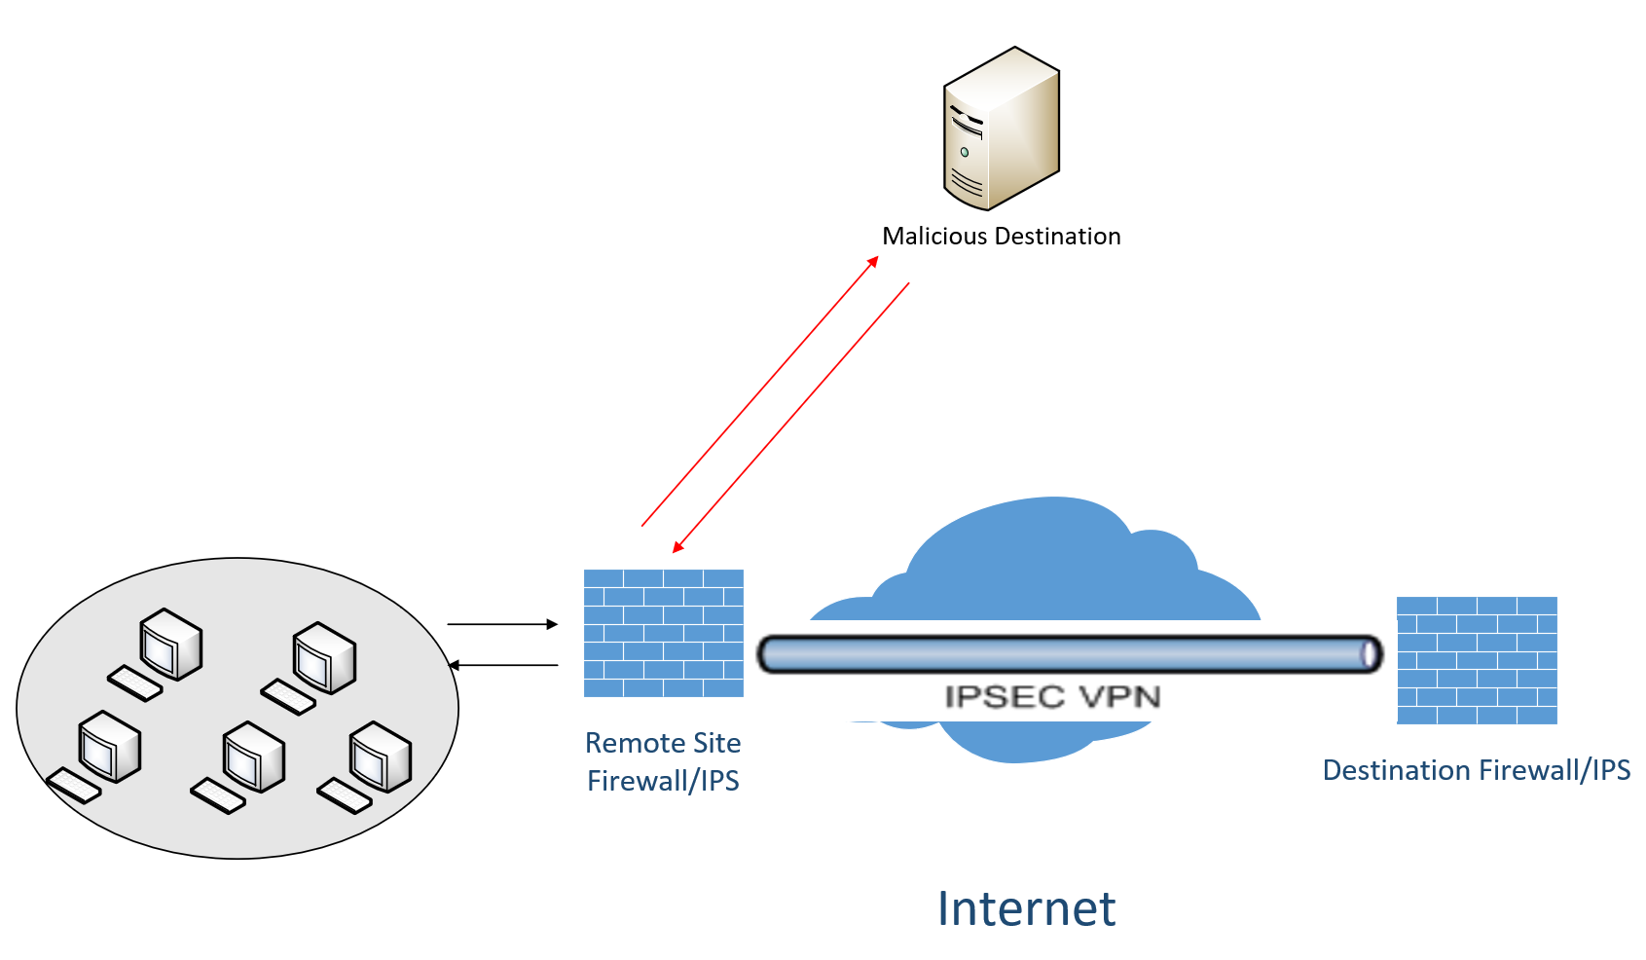
Jason’s Deli [Control Recommendations]
Identify PCI data and how it is processed
Input -> Output
POS have a very limited attack surface if adhering to payment card industry’s set of standards (PCI)
Card data only vulnerable when data in decrypted for a short time in RAM
Physical Protection
Limit POS exposure to unauthorized physical access
Malicious code detection
POS systems should always be isolated via segmentation
All inbound connections would be blocked
Outbound connections would be restricted to specifically defined destination IPs
Zero Trust Model
All connections would be monitored and audited
Breach would have been identified within hours

Slide 12
References
Ballad, B., Banks, E, K., Chapple, M., Ballad, B. (2017). Access Control, Authentication, and Public Key Infrastructure, Second Edition. Burlington, MA. Jones & Bartlett Learning.
Framework for Improving Critical Infrastructure Cybersecurity. (2014). Retrieved from https://www.nist.gov/sites/default/files/documents/cyberframework/cybersecurity-framework-021214.pdf
Insider Threat Report: 2018. (n.d.). Retrieved from https://www.ca.com/content/dam/ca/us/files/ebook/insider-threat-report.pdf
Kolodny, L. (2018). Tesla is seeking $167 million in damages from the former employee Elon Musk accused of sabotage. Retrieved from: https://www.cnbc.com/2018/12/11/tesla-seeks-167-million-in-damages-from-ex-employee-martin-tripp.html
Krebs on security. (2018). Retrieved from https://krebsonsecurity.com/2018/07/hackers-breached-virginia-bank-twice-in-eight-months-stole-2-4m/
NIST Special Publication 800-53 Revision 5. Security and Privacy Control for Federal Information Systems and Organizations. (2017). Retrieved from: https://csrc.nist.gov/csrc/media/publications/sp/800-53/rev-5/draft/documents/sp800-53r5-draft.pdf
Overview of data loss prevention | Microsoft Docs. (2019). Retrieved from https://docs.microsoft.com/en-us/office365/securitycompliance/data-loss-prevention-policies
The Boeing Breach: How an Employee Slip-Up Cost Colleagues. (n.d.). Retrieved from https://cyberpolicy.com/cybersecurity-education/the-boeing-breach-how-an-employee-slip-up-cost-colleagues
Tung, L. (2018). Tesla: We’re now suing ex-employee for alleged theft of gigabytes of trade secrets. Retrieved from https://www.zdnet.com/article/tesla-were-now-suing-ex-employee-for-alleged-theft-of-gigabytes-of-trade-secrets/
Vijayan, J. (2018). Tesla Employee Steals, Sabotages Company Data. DarkReading. Retrieved from https://www.darkreading.com/informationweek-home/tesla-employee-steals-sabotages-company-data/d/d-id/1332098
What is Azure Information Protection? - AIP | Microsoft Docs. (2019). Retrieved from https://docs.microsoft.com/en-us/azure/information-protection/what-is-information-protection

